Slide 1
Beyond the Classroom
Applied Learning Theory

Slide 2
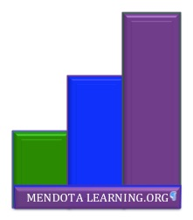
Introduction
Mendota Learning Project
  www.listenlovelead.com/education
Application of Learning Theory
  Problem
  Proposal
  Literature
  Application
  Example

Slide 3
The Problem
Dependent Students

Slide 4
Educating the Masses is Easy
  Decide what they need to know.
    E.g. Common Core or Accreditation
  Decide how they will learn it.
    E.g. Education Policy
  Create an assessment mechanism to measure success.
    E.g. Standardized Testing

Slide 5
Problem!!!
  The masses are made up of individuals
  Build a mold for one person and only one person will fit!
  Natural barriers for non-homogenous individuals – especially minorities (Brookfield)
  Success comes at the sacrifice of individuality (Palmer)

Slide 6
The Teaching/Learning Cycle
  Teacher masters information
  Communicates information to students
    Hopefully with diverse methods
  “Those to whom the provided conditions were suitable managed to learn” (Dewey, p. 45).
  Teacher analyzes transfer of knowledge by requesting information back from students.
  Students forget most of the information (Sousa)
Information
Teacher
Student

Slide 7
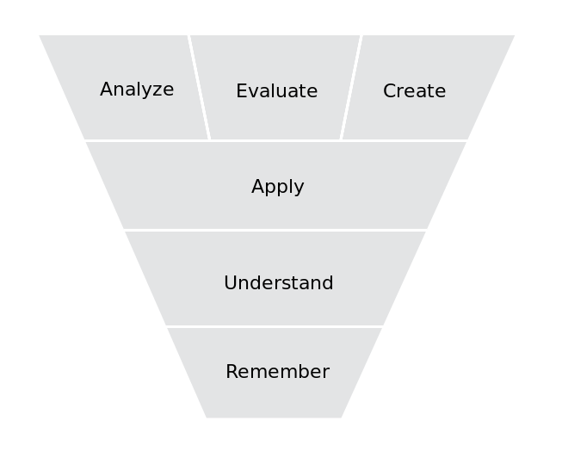
Dependent Students
  “Tell me what I need to know to pass this class.”
  Minimum standards
  Sense of entitlement
    Gen Y
  Moving toward the wrong end of Bloom’s Taxonomy.

Slide 8
Missing the Objectives
  Critical Thinking
  Empowered Independent Learners
  Learning Transfer
  Transformation of the Individual
  Mastery of the Subject
  (Brookfield, 2013; Kaiser, Kaminski, & Foley, 2013; Palmer, 2007; Merriam & Bierema, 2014)

Slide 9
Proposal
Empowering Students

Slide 10
The answer is NOT more information
  Difference between difficulty and complexity of learning (Sousa, p. 263)
  Dependent – Interested – Involved – Self Directed (Merriam & Bierema, p. 70).
  How do we equip students to learn outside of the school setting?

Slide 11
Impact of Technology
  Thanks to technology, information and knowledge are widely accessible.
  Students need guidance to apply this information at higher levels of Bloom’s Taxonomy (Ghaffari, 2008).
  “Coaching is particularly critical at the skill level just beyond what the learner/apprentice could accomplish by him or her self (Merriam & Bierema,p. 119).

Slide 12
  Design self directed experiential learning opportunities that equip adults to become lifelong learners.

Slide 13
The Literature

Slide 14
Fields of Literature
  Andragogy
    Experience and Learning
  Critical Theory
    Testing Assumptions
  Transformative Learning
    Communities of Practice
    Reflection
  Self-directed Learning
    Empowering Students

Slide 15
  “[The teacher’s]…ability to influence directly the experience of others and thereby the education they obtain places upon him the duty of determining that environment which will interact with the existing capacities and needs of those taught to create a worth-while experience” (Dewey, p. 45).

Slide 16
Experience and Education
  “For Aristotle, all knowledge or theory needs to be tested in the real world of our everyday experience…” (Merriam & Bierema, 2014, pp. 104-105).
  Accessible learning experiences (Merriam & Bierema, p. 66)
  Continuity: Experiences must build upon each other (Dewey, p. 51).
  "Physical, emotional, cognitive, social and spiritual" aspects of experience (Merriam & Bierema, 2014, p.104)
  Andragogy uses opportunities of learning from individuals own environments (Merriam & Bierema, p. 66)

Slide 17
Communities of Practice (p. 121)
  Dewey – continuity and interaction
  Brookfield (Brookfield, xii) – discussion is considered to be the most “adult” learning
  Mezirow – emotions, intuition, context, and relationships play a role in the transformational learning context
  Montessori - blended different levels of students to model learning and skills

Slide 18
  “…some students are speaking more and dominating the class because of the power they exercise in their roles outside the classroom…” (Brookfield, p.2).

Slide 19
Critical Theory
  Identify underlying assumptions
  Palmer’s use of space within a classroom (Palmer, pp. 76-80).
  Incorporate critical theory to identify underlying assumptions about learning, education, and the individual.

Slide 20
  Transformational learning culminates in a "clearer or more pronounced understanding of self and one's role in the world” (Charaniya, 2012, p. 231 as cited in Merriam & Bierema, 2014).

Slide 21
Transformative Learning
  Not all experiences lead to positive education. (Dewey, p. 87)
  Opportunities for reflection (Merriam & Bierema, p. 64)
  Making meaning of experience (Merriam & Bierema, p. 84)

Slide 22
  “As teachers we can work to remove barriers and to help students develop knowledge, skills, and confidence, but only students can empower themselves. Empowerment, after all, can only be claimed, not given” (Brookfield, p. 3).

Slide 23
Self – Directed Learning
  Evaluation and adjustment of the learning process
    Costa and Kallick's criteria for self directed learner Assessment (Merriam & Bierema, p. 75)
    self managing, self monitoring, self modifying
  Bloom’s Taxonomy
  Objective of learning transfer
    Equip adults to learn outside the classroom in any setting.

Slide 24
Applying the Solution

Slide 25
Role of the Teacher
  Design self directed experiential learning opportunities that equip adults to become lifelong learners.
  Educators have an active individualized approach to the education process (Merriam & Bierema, p. 66).

Slide 26
Disrupt the Learning Cycle
To Information
Teacher Analyzes
Which Student Apply
Designs Experiences
That Teach Learning Methods

Slide 27
New Learning Cycle
  Emphasize experiences that teach learning methods
  Empower students to seek and develop information on their own
  Provide opportunities for creativity
  Teachers assess the process and creative outcome to determine mastery and future learning

Slide 28
Difficulties in Transition
  Students are already dependent
  Need to create accessible transitions
  Teach them how to transfer what they know.
  Re-inspire with passion for learning.

Slide 29
  “On one side were the scholars, insisting that the subject is primary and must never be compromised for the sake of the students’ lives. On the other side were the student - centered folks, insisting that the lives of students must always come first even if it means that the subject gets short-changed” (Palmer, p. 13).

Slide 30
Use the Subject to Teach
  Design self directed experiential learning opportunities that equip adults to become lifelong learners.
  Use the subject to teach students how to learn.

Slide 31
Integrating Virtual Learning?
  Integrated information creation and sharing resource.
    (Baraniuk, 2006)
  Communication technologies for synchronous and asynchronous discussion.
  External portal for sharing internal developments of knowledge.

Slide 32
Example:
Learning Seminar

Slide 33
Day One
  Community building activity
  Explore individuality through tests of personality and learning styles
  Create teams of similar learners to explore their difficulties and strengths in the process
  Representatives of teams present synthesized observations to the whole group.
  Time for reflection and conversation over drinks.

Slide 34
Day Two
  Recap of previous day by asking for shared reflections
  Break into small groups to explore the assumptions of what it means to learn.
  Success story presentations of individuals who learned how to learn
  Teams of similar individuals create a preliminary strategy for learning and record their process.
  Sharing strategies. Individuals offer feedback and ask questions.
  Individuals revise their strategy and reflect on the process of developing it. How can they apply it in other contexts?

Slide 35
Review:

Slide 36
Problem
Dependent Students
Ineffective transfer
Poor teaching/learning cycle

Slide 37
Proposal
  Design self directed experiential learning opportunities that equip adults to become lifelong learners.

Slide 38
The Literature
Experience
Community
Testing Assumptions
Reflection
Self Direction

Slide 39
The New Model
Teacher becomes a designer
  Design self directed experiential learning opportunities that equip adults to become lifelong learners.
Students learn how to learn in the context of a subject
Transformed into lifelong self-directed learners
Applying their educational skills Beyond the Classroom!

Slide 40
How can you help?
Go through this process yourself
Use this model with your students
Visit my website and add to the conversation
  www.listenlovelead.com/education

Slide 41
References
Baraniuk, R. (2006, February). The birth of the open-source learning revolution [Video file]. Retrieved from http://www.ted.com/talks/richard_baraniuk_on_open_source_learning
Brookfield, S. (2009). Powerful techniques for teaching adults. San Francisco, CA: Jossey-Bass.
Dewey, J. (1997). Experience & Education. New York, NY: Simon & Schuster.
Ghaffari, M. (2008). Digitialized lectures: Making education more “student centered”. International Journal of Technology, Knowledge and Society, 4(5), 107-118. Retrieved from http://search.proquest.com/docview/868010305?accountid=10223

Slide 42
References
Kaiser, L. M. R., Kaminski, K., & Foley, J. M. (Ed.s) (2013). Learning transfer in adult education. New Directions for Adult and Continuing Education, 137. San Franciso, CA: Jossey-Bass.
Merriam, S. B. & Bierema, L. L. (2014). Adult learning: linking theory and practice. San Fancisco, CA: Jossey-Bass.
Palmer, P. J. (2007). The courage to teach. San Francisco, CA: Jossey-Bass.
Sousa, D. A. (2011). How the brain learns. 4th Edition. Thousand Oaks, CA: Corwin.

Slide 43
[The End]
Visit www.listenlovelead.com/education for more information, resources, ideas and inspiration in your journey as an effective and empowered educator.

